Slide 1
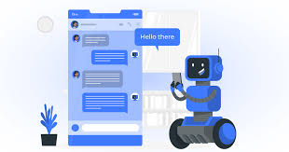
Department of Data Science
II B.Tech II Semester Mini Project-2024
Submitted by Batch -01
API BOT
NAMES: ROLL NO:
K.Tanuja 22R21A67F7
A.Sai Sushma 22R21A67D4
P.Manusha 22R21A67H6
Supervisor:
Mr.Ashok Babu Assistant Professor Department of Data Science

Slide 2
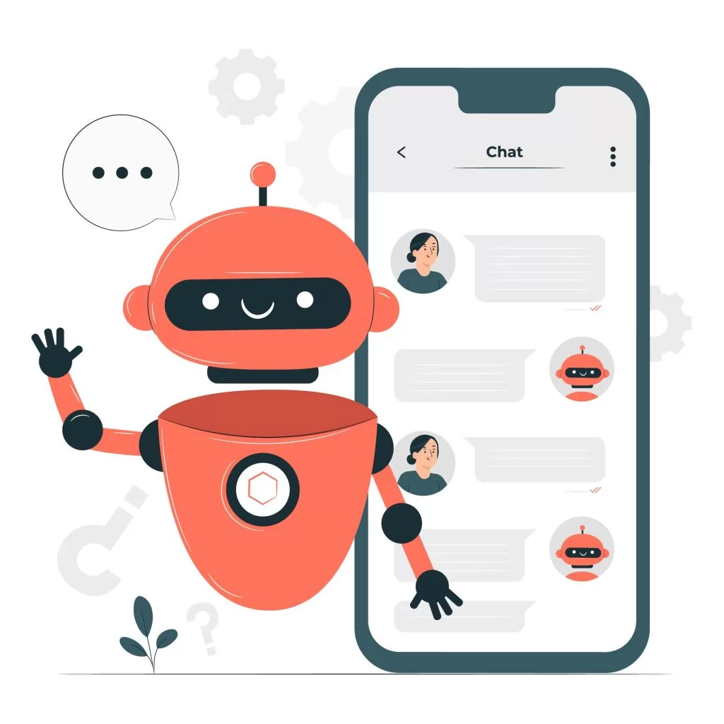
CONTENTS:
Abstract
Introduction
Project objectives
Existing system
Proposed system
Advantages
Disadvantages
Requirements
Code highlights
Final output
Conclusion
Reference

Slide 3

ABSTRACT:
This project aims to create an interactive API BOT using Gemini API.
It helps to design and develop an innovative bot that leverages the power of Python libraries like Selenium and Gradio.
The bot will have the capability to control the screen, interact with web applications, and provide an interface for users.
The combination of these technologies enables the creation of an interactive API BOT and modern web technologies, providing an immersive and educational experience for users.

Slide 4
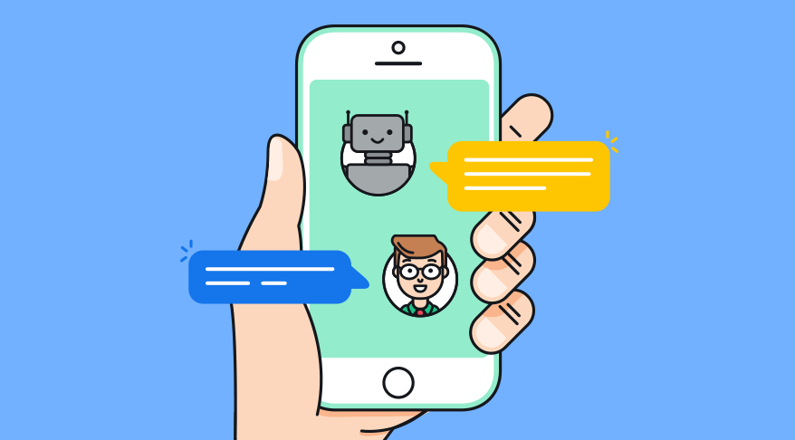
INTRODUCTION:
Developed an API BOT using python libraries.
Our project uses Python to control screen and build interfaces.
We use two libraries: Selenium to automate tasks and Gradio to create user-friendly interfaces.
Selenium, a widely-used tool for web automation, allows our bot to navigate and interact with digital environments with precision and speed. Meanwhile, Gradio's user-friendly interface capabilities ensure a seamless and engaging user experience, can be added as a new feature to Whatsapp.

Slide 5
PROJECT OBJECTIVES:
Screen control and automation using Selenium.
Interactive interface and visualization using gradio.
Machine learning and training capabilities.
Versatility and adaptability to various web applications and APIs.

Slide 6
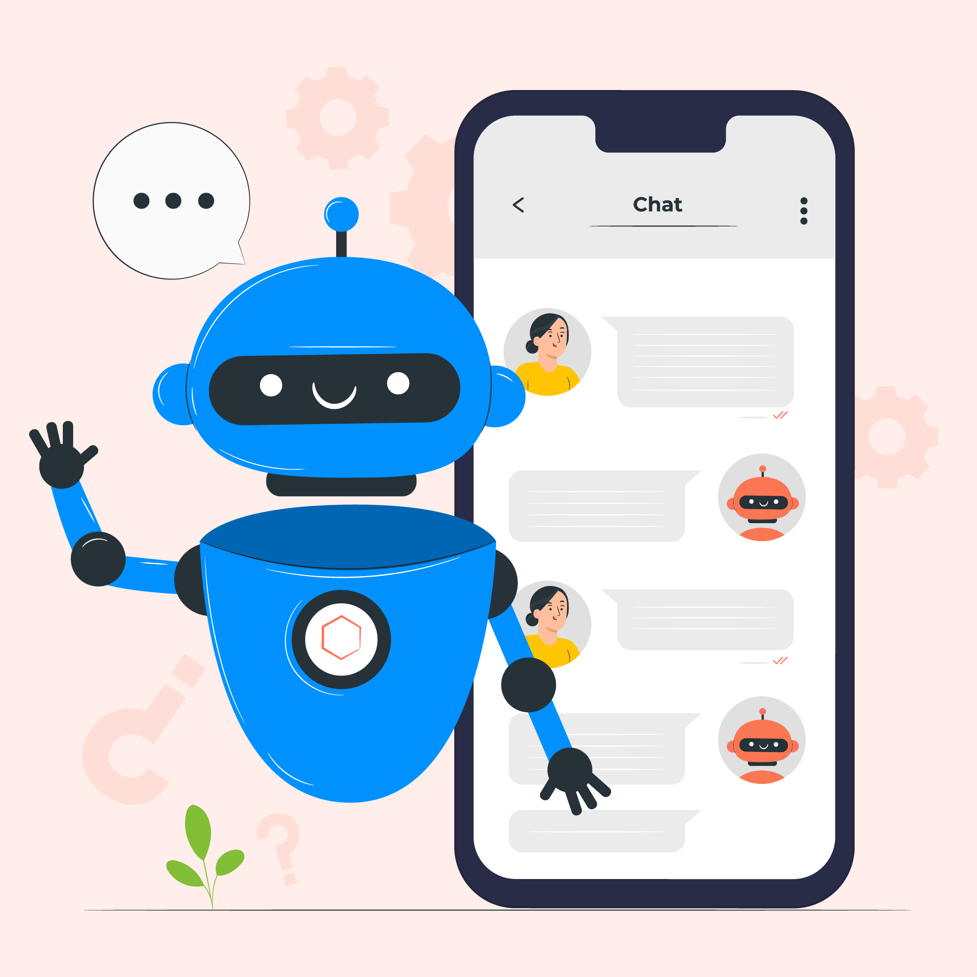
EXISTING SYSTEM:
WhatsApp is a popular messaging platform with
over 2 billion users worldwide. It allows users to send text
messages, make voice and video calls, share media files, and
more.
OpenAI provides a powerful API that allows
developers to access advanced language models, such as
GPT-3, for building conversational agents.
An “API BOT” is a computer program designed to simulate human
conversation through text or voice interactions.

Slide 7
PROPOSED SYSTEM:
Automated Customer Support: The API BOT will provide
automated customer support by answering frequently asked
questions, addressing common issues, and providing relevant
information to users.
Improve Customer Experience: The system aims to enhance the
overall customer experience by providing quick and accurate
responses to user inquiries.
Content Delivery: API BOT can deliver content directly to users
on WhatsApp.

Slide 8
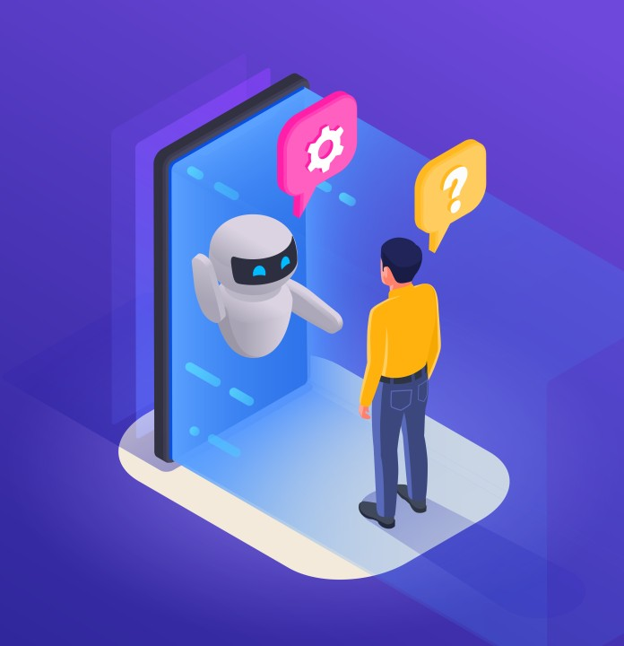
ADVANTAGES:
Easy to Understand.
Less Complexity.
Compatibility.
Low Cost.
Widespread Knowledge.
Flexible Design.

Slide 9
DISADVANTAGES:
Slower Performance.
Integration Difficulty.

Slide 10
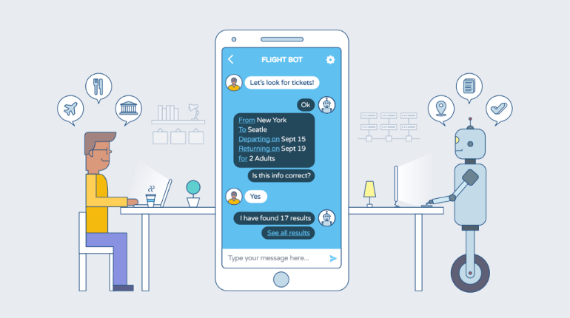
REQUIREMENTS:
Hardware Requirements: None.
Software Requirements:
Programming Languages Used:
Backend: Python fast API.
Frontend: Selenium and Gradio libraries.

Slide 11
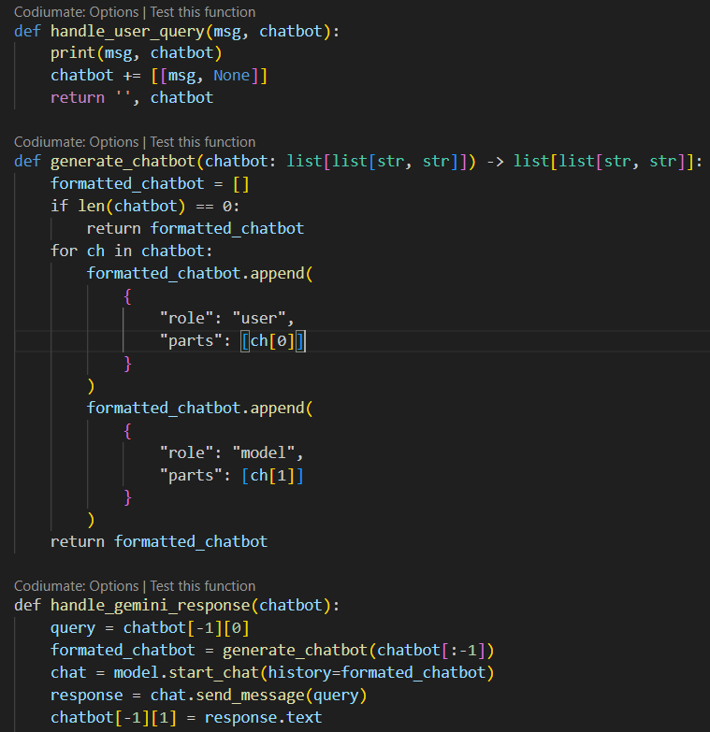
CODE HIGHLIGHTS:
gradio_ui.py

Slide 12
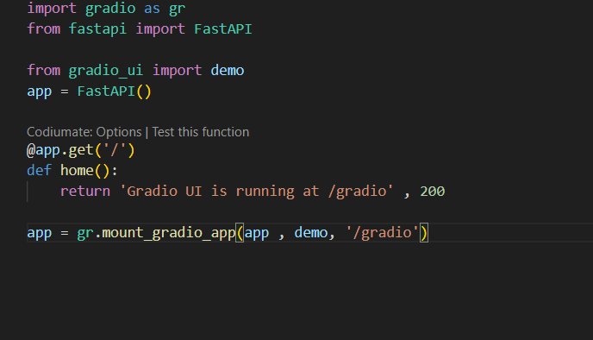
run.py

Slide 13
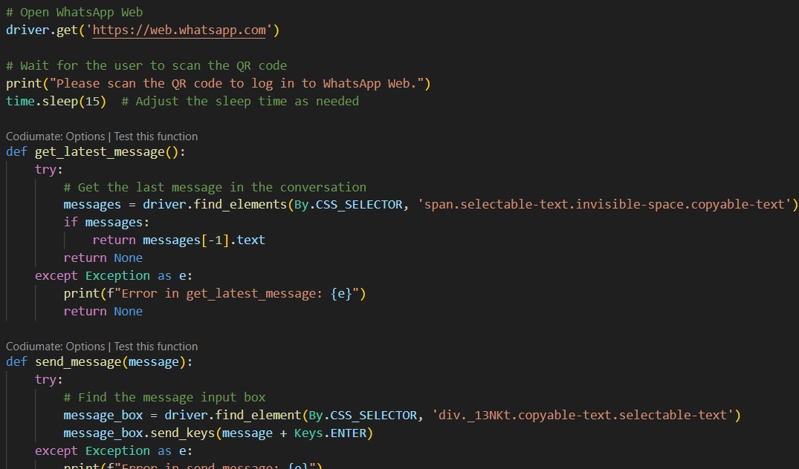
Whatsapp code

Slide 14
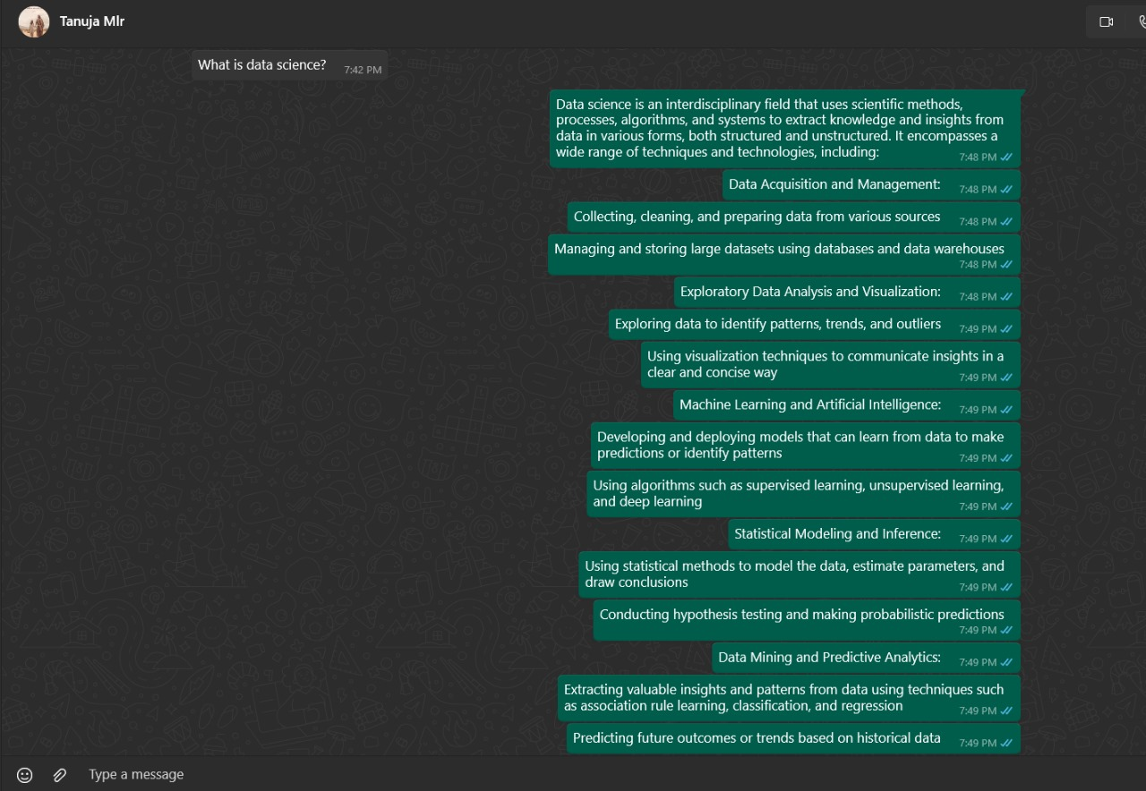
FINAL OUTPUT:

Slide 15
CONCLUSION:
This project successfully creates an interactive API BOT, utilizing Gemini API. Despite not using traditional backend technologies like Node.js and React.js, the project effectively simulates backend functionality Python programming language.
The API BOT is designed to simulate conversation with users and can be integrated into WhatsApp or as a standalone website resembling WhatsApp AI, prioritizing user interaction and experience.
Overall, the combination of these technologies enables the creation of an interactive API BOT that leverages natural language processing and modern web technologies, providing an immersive and educational experience for users.

Slide 16
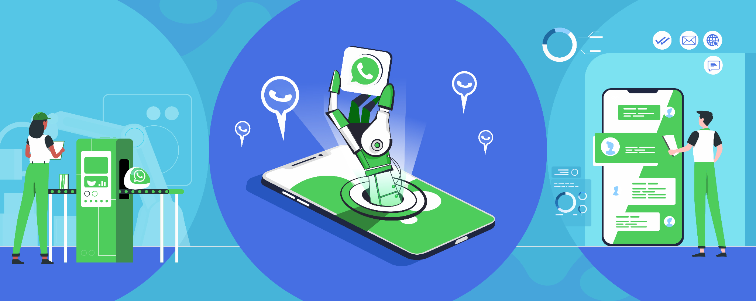
REFERENCE:
https://ai.google.dev/
https://www.gradio.app/
https://fastapi.tiangolo.com

Slide 17
THANK YOU

